Slide 1
Digital Image Portfolio
Doug Tyson
22 June 2016

Slide 2
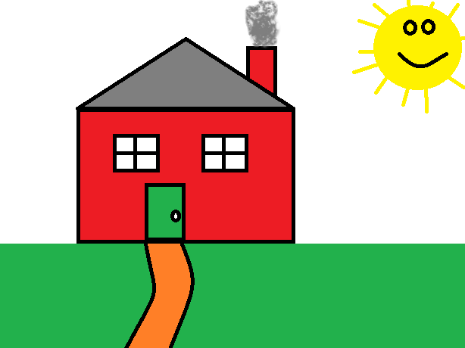
Digital Artwork

Slide 3
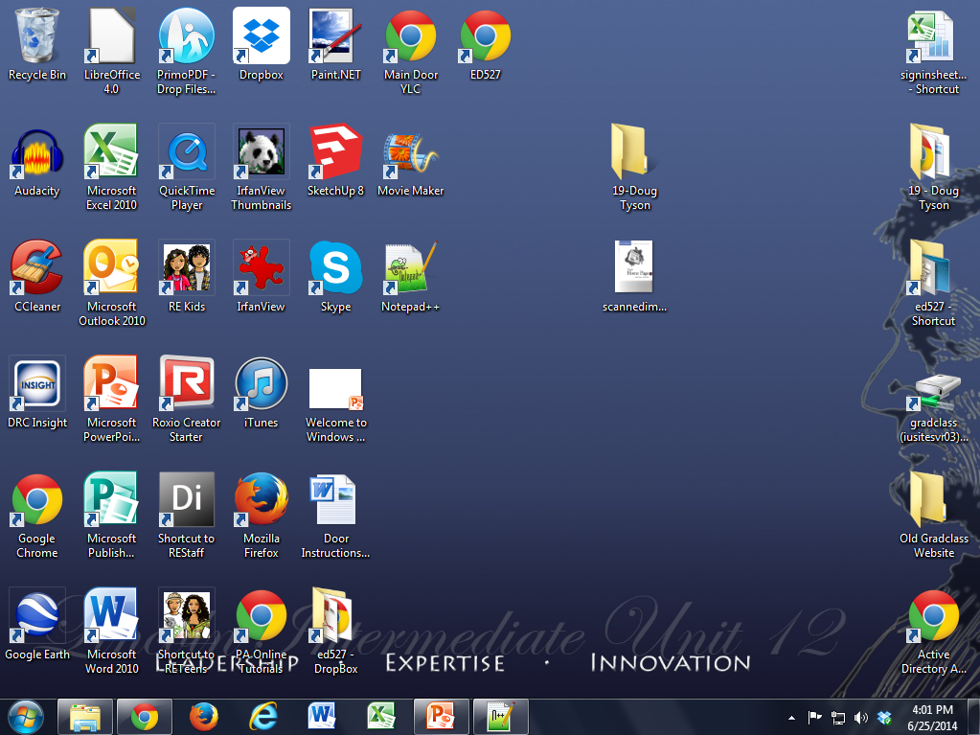
Screen Capture of Desktop

Slide 4

Digital Photograph (Portrait)

Slide 5
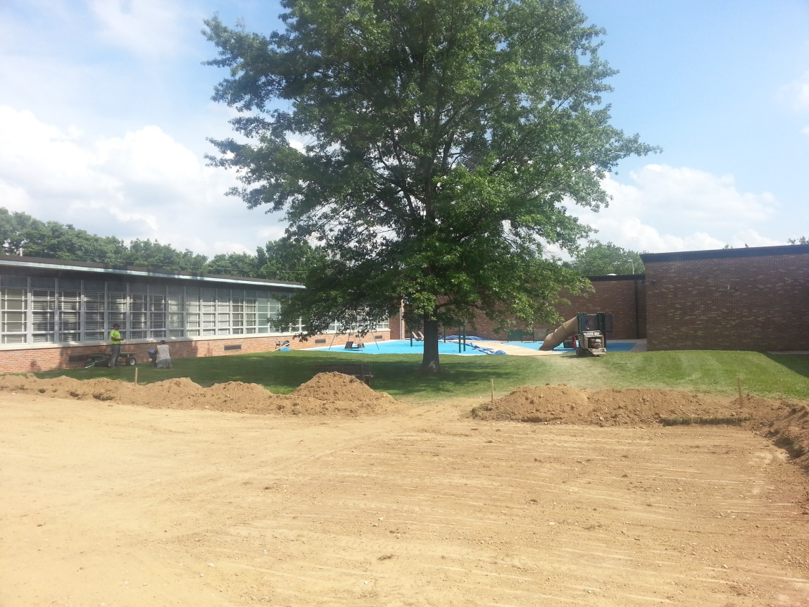
Digital Photograph (Landscape)

Slide 6
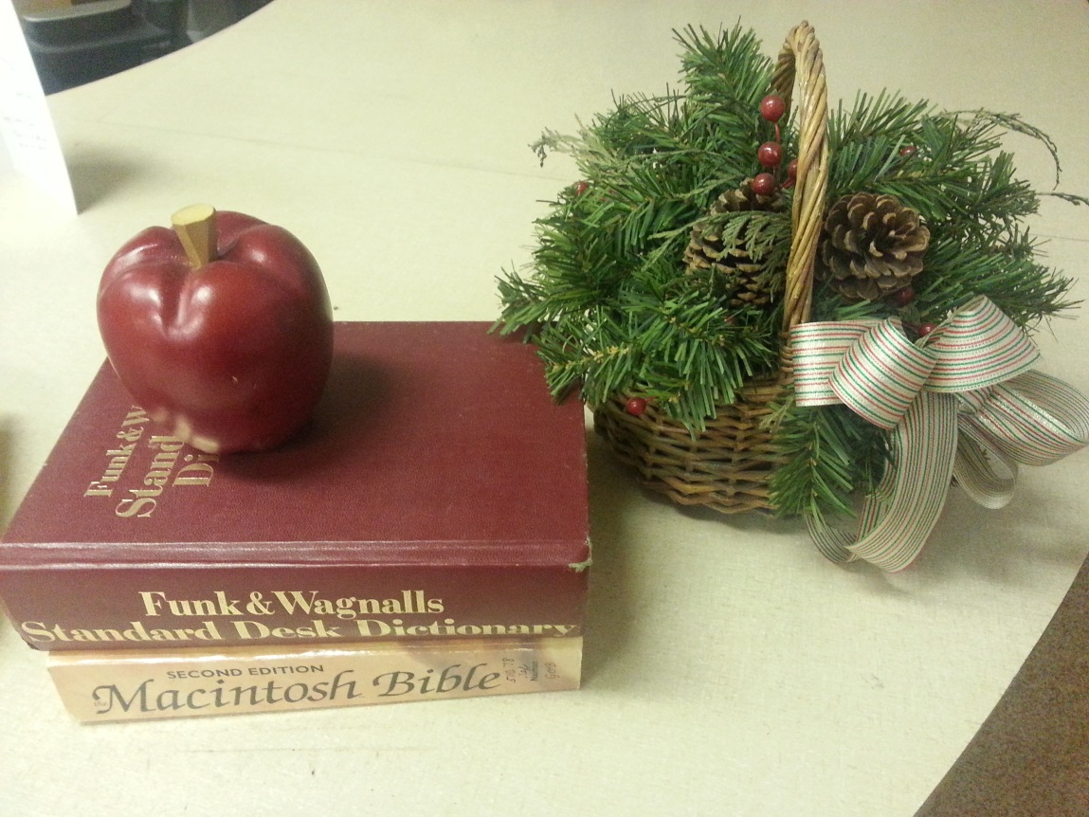
Digital Photograph (Still Life)

Slide 7
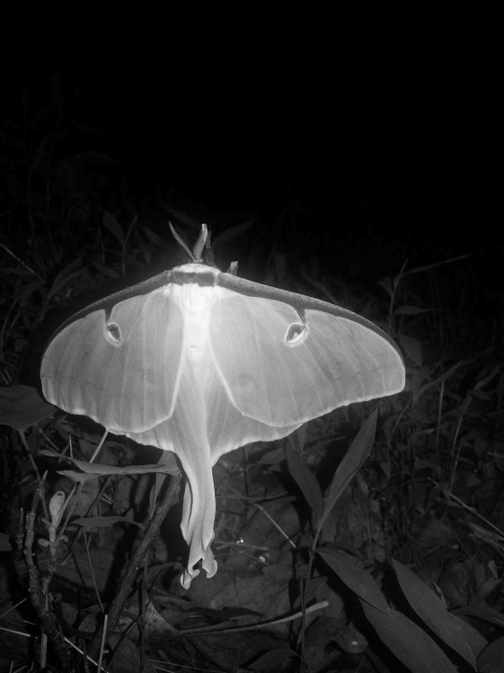
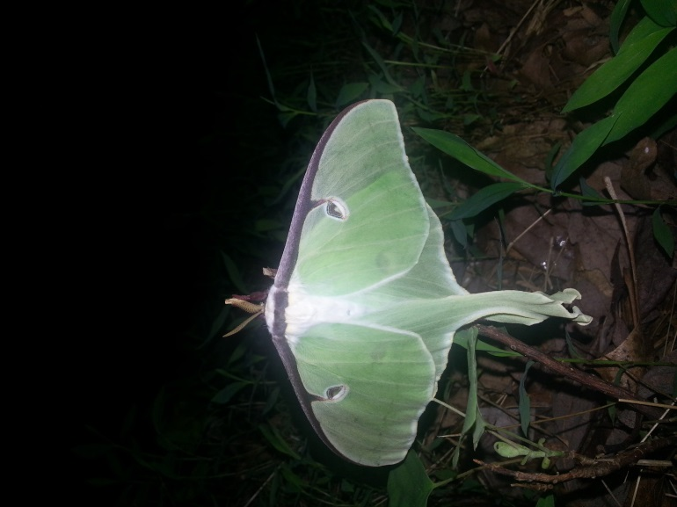
Digital Photo Editing (B&W)
Original Image
Edited Image

Slide 8
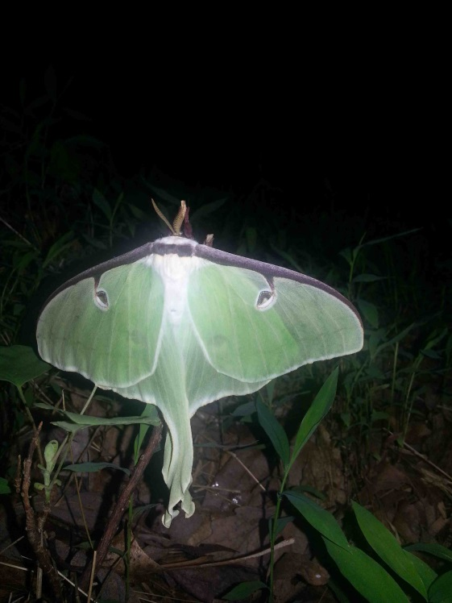
Digital Photo Editing (Red Eye Red.)
Original Image
Edited Image

Slide 9
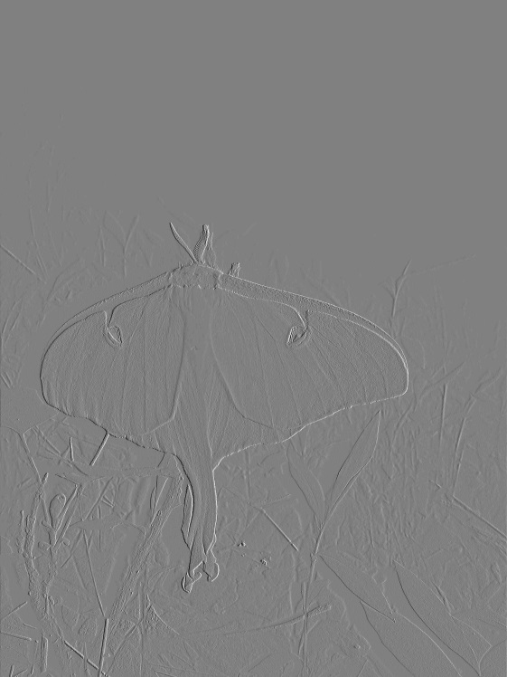
Digital Photo Editing (Special Filter)
Original Image
Edited Image- Emboss

Slide 10
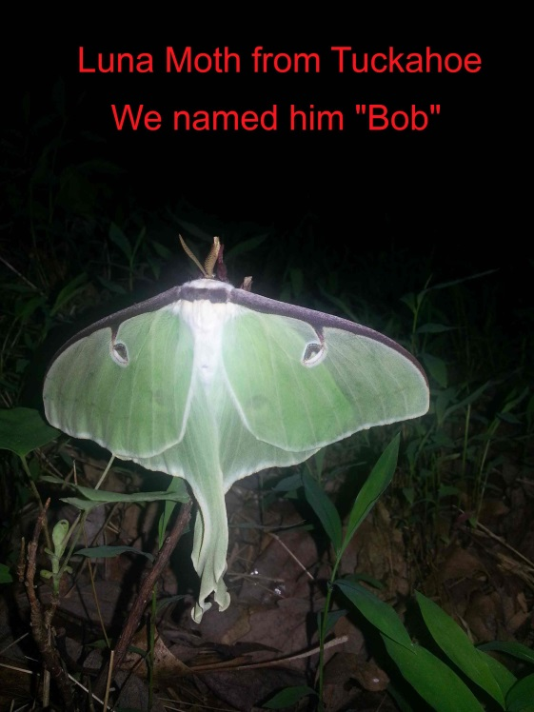
Digital Photo Editing (Capt./Labels)
Original Image
Edited Image

Slide 11
Digital Photo Editing (Rotate Image)
Original Image
Edited Image

Slide 12

Scanned Image

Slide 13
Assignment Reflection
Your thoughts here (200-300 words).

